Slide 1
Community Structure Louvain Algorithm
MA 653: Network Science
Instructor: Ashok Singh Sairam
ashok@iitg.ac.in

Slide 2
Review: Modularity Score
Compute the modularity score of the two communities – {1, 4, 5, 7 } and {2, 3, 6, 8}
7
5
3
4
1
8
6
2

Slide 3
The Louvain Algorithm
It is an agglomerative algorithm
Bottom-up approach: Start with single cluster and then progressively merge with its closest neighbour
Greedy algorithm
Weighted graphs
Used in many application domains because of its
rapid convergence
high modularity
hierarchical partitioning

Slide 4
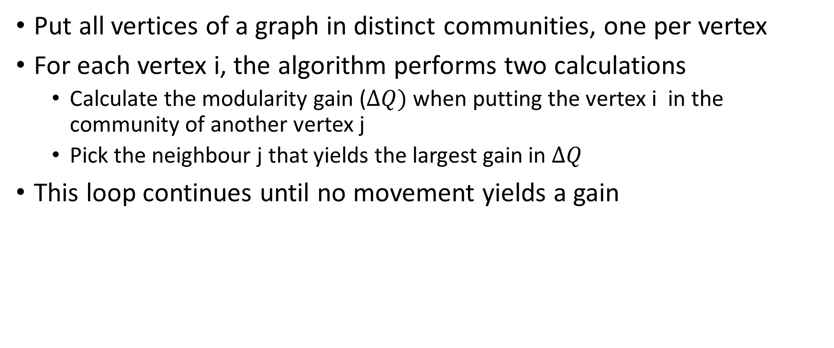
First step: First level partitions
Put all vertices of a graph in distinct communities, one per vertex
For each vertex i, the algorithm performs two calculations
Calculate the modularity gain ($∆Q)$ when putting the vertex i in the community of another vertex j
Pick the neighbour j that yields the largest gain in $∆Q$
This loop continues until no movement yields a gain

Slide 5
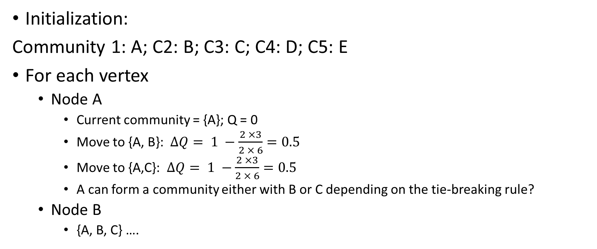
Example: First Level
Initialization:
Community 1: A; C2: B; C3: C; C4: D; C5: E
For each vertex
Node A
Current community = {A}; Q = 0
Move to {A, B}: $ΔQ= 1 −\frac{2 ×3}{2 × 6}=0.5$
Move to {A,C}: $ΔQ= 1 −\frac{2 ×3}{2 × 6}=0.5$
A can form a community either with B or C depending on the tie-breaking rule?
Node B
{A, B, C} ….
A
B
C
D
E

Slide 6
Other steps: Hierarchical structure
In the next round, we repeat the same procedure but instead of moving a single vertex, we move whole groups
Two super vertices are connected, if there is at least one edge between vertices of the corresponding partitions
The above two steps continue, until the communities become stable

Slide 7
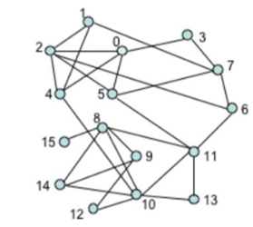
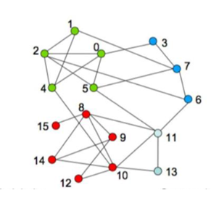


Slide 8
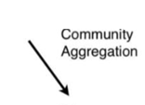
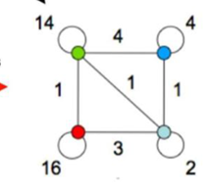

Slide 9
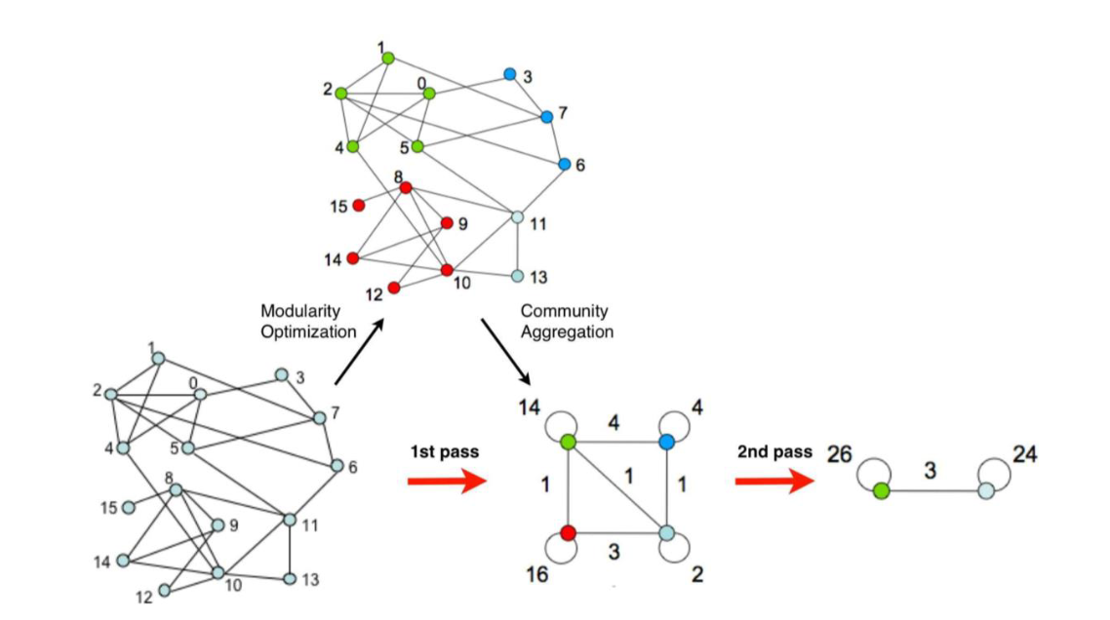

Slide 10
Louvain Algorithm: Complexity
Single round is expected to take: O(m+n)
# rounds: O(log n)
Thus total running time: O((m+n)log n) or O(n log n)
In practice, the Louvain algorithm is fast enough for very large networks

Slide 11
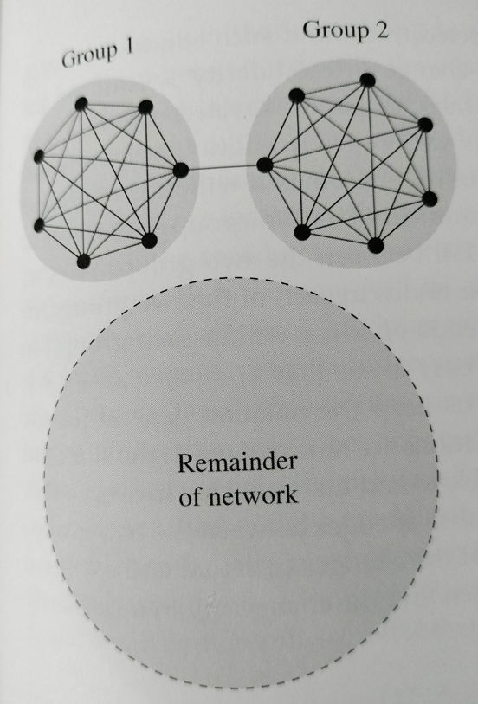
Resolution Limit for Modularity Maximization
Even where it is possible to maximize modularity, the resulting algorithm would not give perfect
Specifically, it suffers from a resolution limit
Inability to see communities in a network if they are too small
Consider two cliques connected by a single edge
So the two groups have strongest intra-group connection and weakest inter-group connection.
But the modularity maximization method will not be able to detect them as separate groups

Slide 12
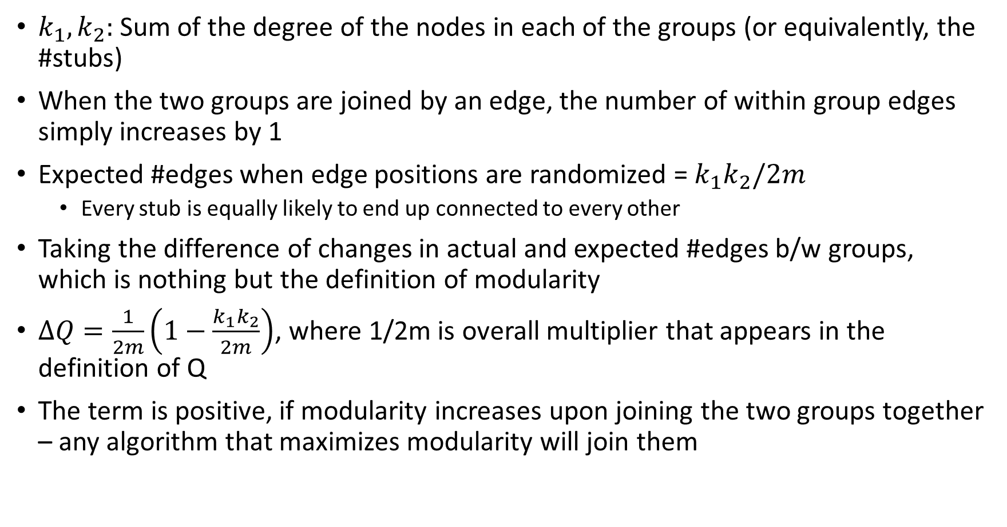
$k_{1}, k_{2}:$ Sum of the degree of the nodes in each of the groups (or equivalently, the #stubs)
When the two groups are joined by an edge, the number of within group edges simply increases by 1
Expected #edges when edge positions are randomized = $k_{1}k_{2}/2m$
Every stub is equally likely to end up connected to every other
Taking the difference of changes in actual and expected #edges b/w groups, which is nothing but the definition of modularity
$ΔQ=\frac{1}{2m}\left(1−\frac{k_{1}k_{2}}{2m}\right)$, where 1/2m is overall multiplier that appears in the definition of Q
The term is positive, if modularity increases upon joining the two groups together – any algorithm that maximizes modularity will join them

Slide 13
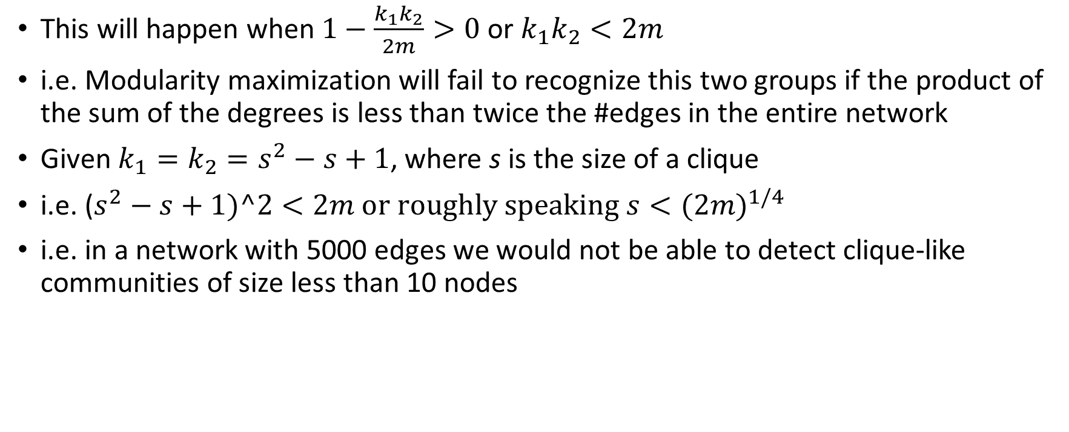
This will happen when $1−\frac{k_{1}k_{2}}{2m}>0$ or $k_{1}k_{2}<2m$
i.e. Modularity maximization will fail to recognize this two groups if the product of the sum of the degrees is less than twice the #edges in the entire network
Given $k_{1}=k_{2}=s^{2}−s+1$, where s is the size of a clique
i.e. ($s^{2}−s+1)^2<2m or roughly speaking s<{(2m)}^{1/4}$
i.e. in a network with 5000 edges we would not be able to detect clique-like communities of size less than 10 nodes

Slide 14
Assessments
Quiz II : 16-Apr-2024
Assignment 2: Submission and Demo: 25-Apr-2024

